Slide 1
Indoor 3D Mapping & Object Localization using Unmanned Ground Vehicle
Vamsee Krishna Kella, MS RAS (EE)
Shivani Bandirala, MS RAS (EE)
Anup Renikunta, MS RAS (AI)

Slide 2
Inspiration
“Search for Survivors & Objects in unkown environment”
3D Dynamic Scene Graphs: Actionable Spatial Perception with Places, Objects, and Humans
Antoni Rosinol, Arjun Gupta, Marcus Abate, Jingnan Shi, Luca Carlone
Laboratory for Information & Decision Systems (LIDS)
Massachusetts Institute of Technology

Slide 3
Approch

Slide 4
Navigate an Environment and generate a 3D Map of the Environment.
Detect the Object
Localization of Object
Localization
Object Detection
Mapping

Slide 5
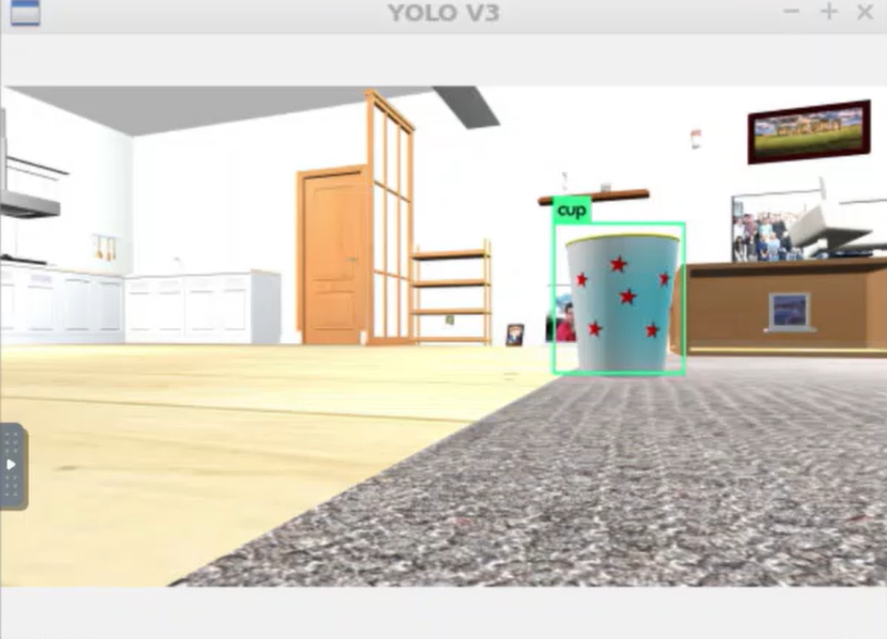
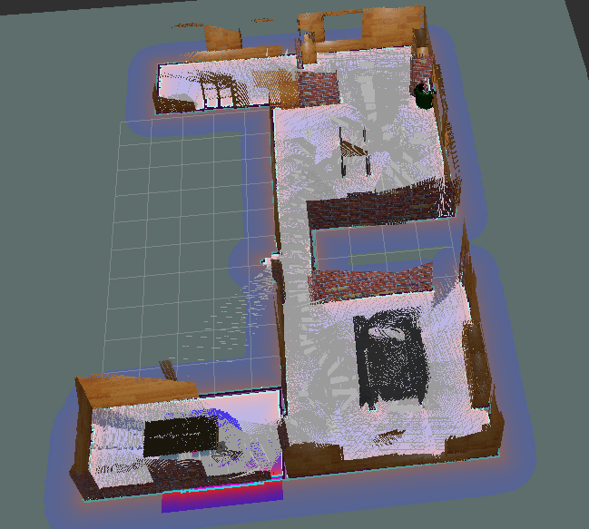
Overview
Color Image
Darknet Ros
RealSense D435
Depth Image
Object Detection
Jsk_pcl_ros
Depth Points
Object Pose
Odometry
Rtabmap
UGV
LaserScan
3D Mapping

Slide 6
Implementation

Slide 7
Simulation
Gazebo
World : AWS Small House world
Mobile Robot : TurtleBot3 Waffle Model
Visualization
rviz
rtabMap

Slide 8
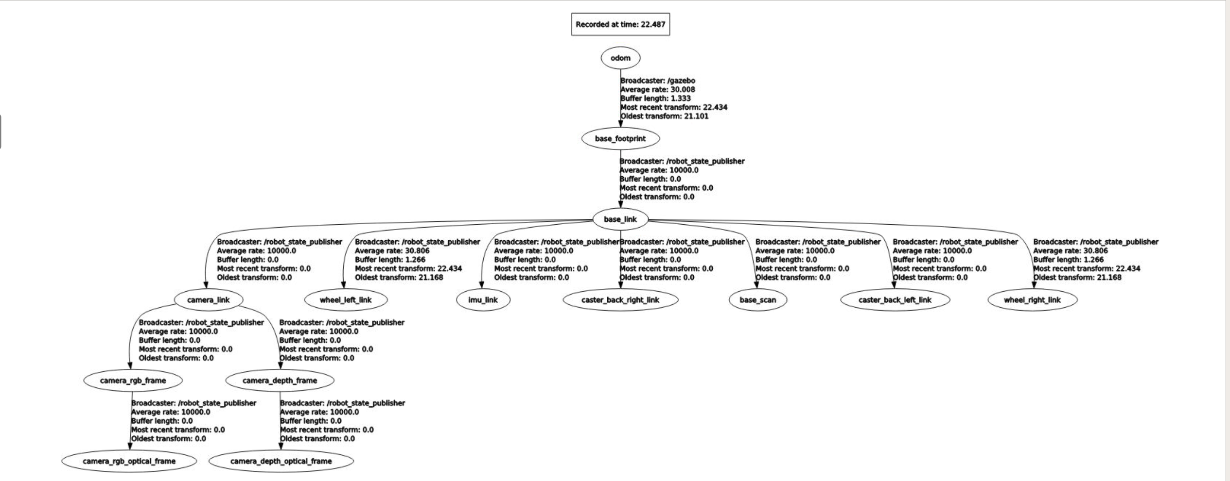

Slide 9
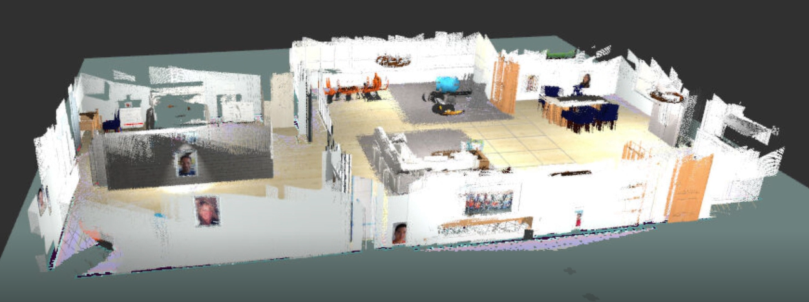
3D Mapping

Slide 10
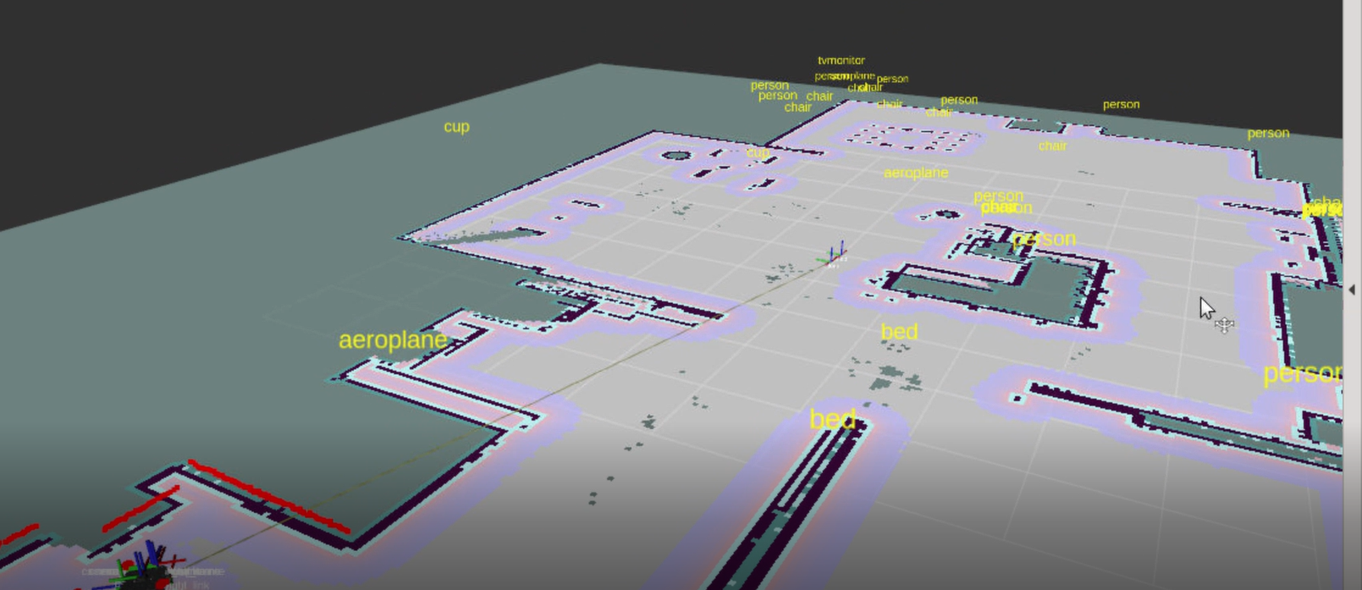
Object Localization

Slide 11
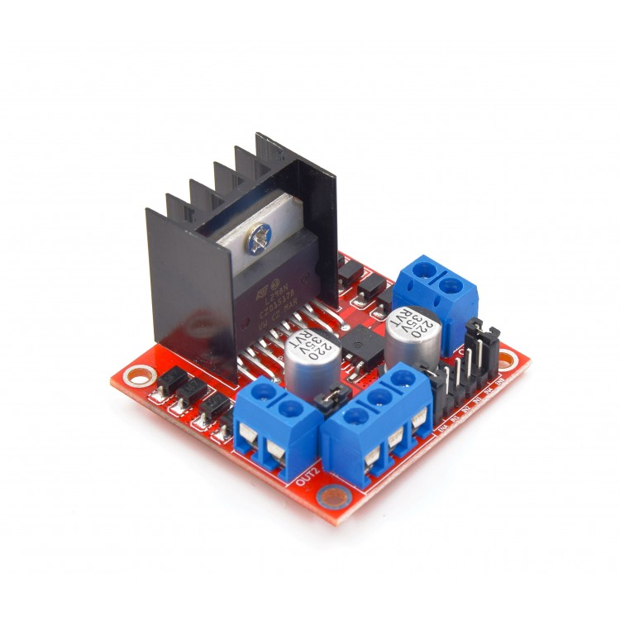
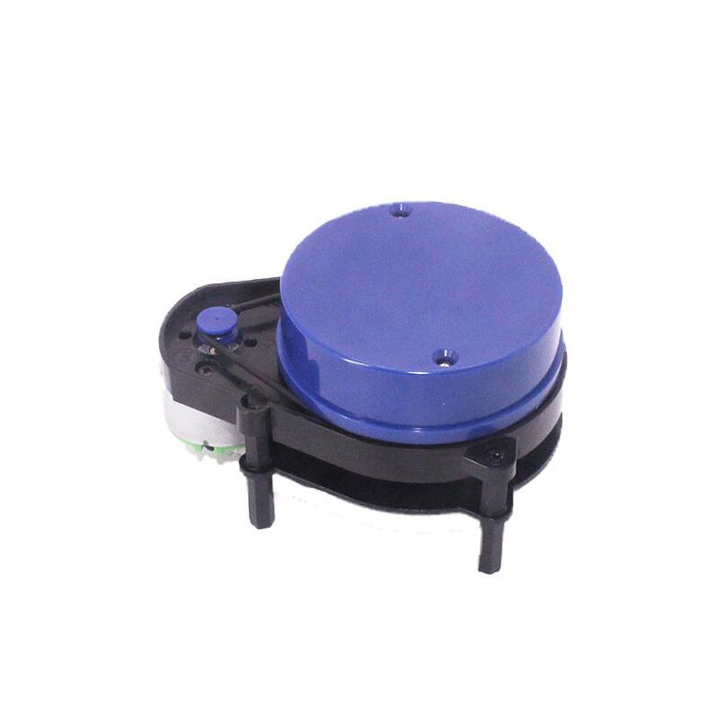
Hardware
Major Components
Raspberry Pi 4
L298 Motor Driver
RealSesne D435 Camera
Yd LiDAR X4

Slide 12
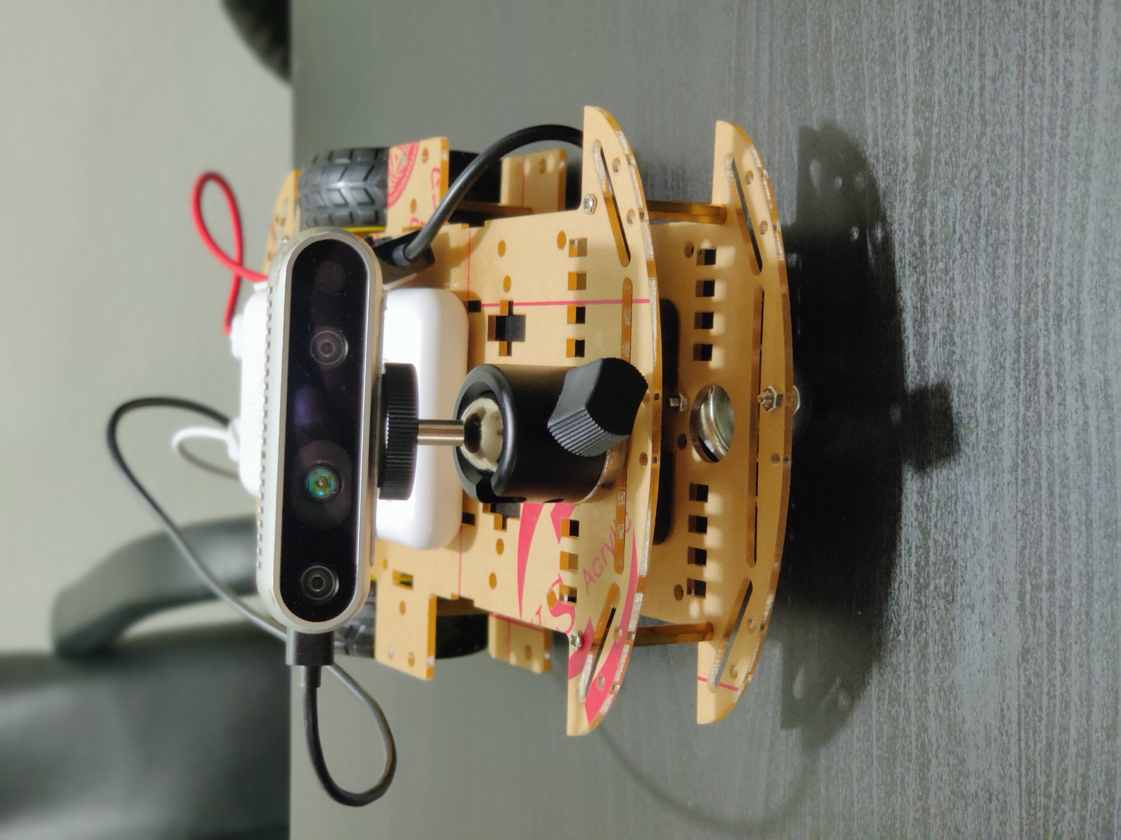
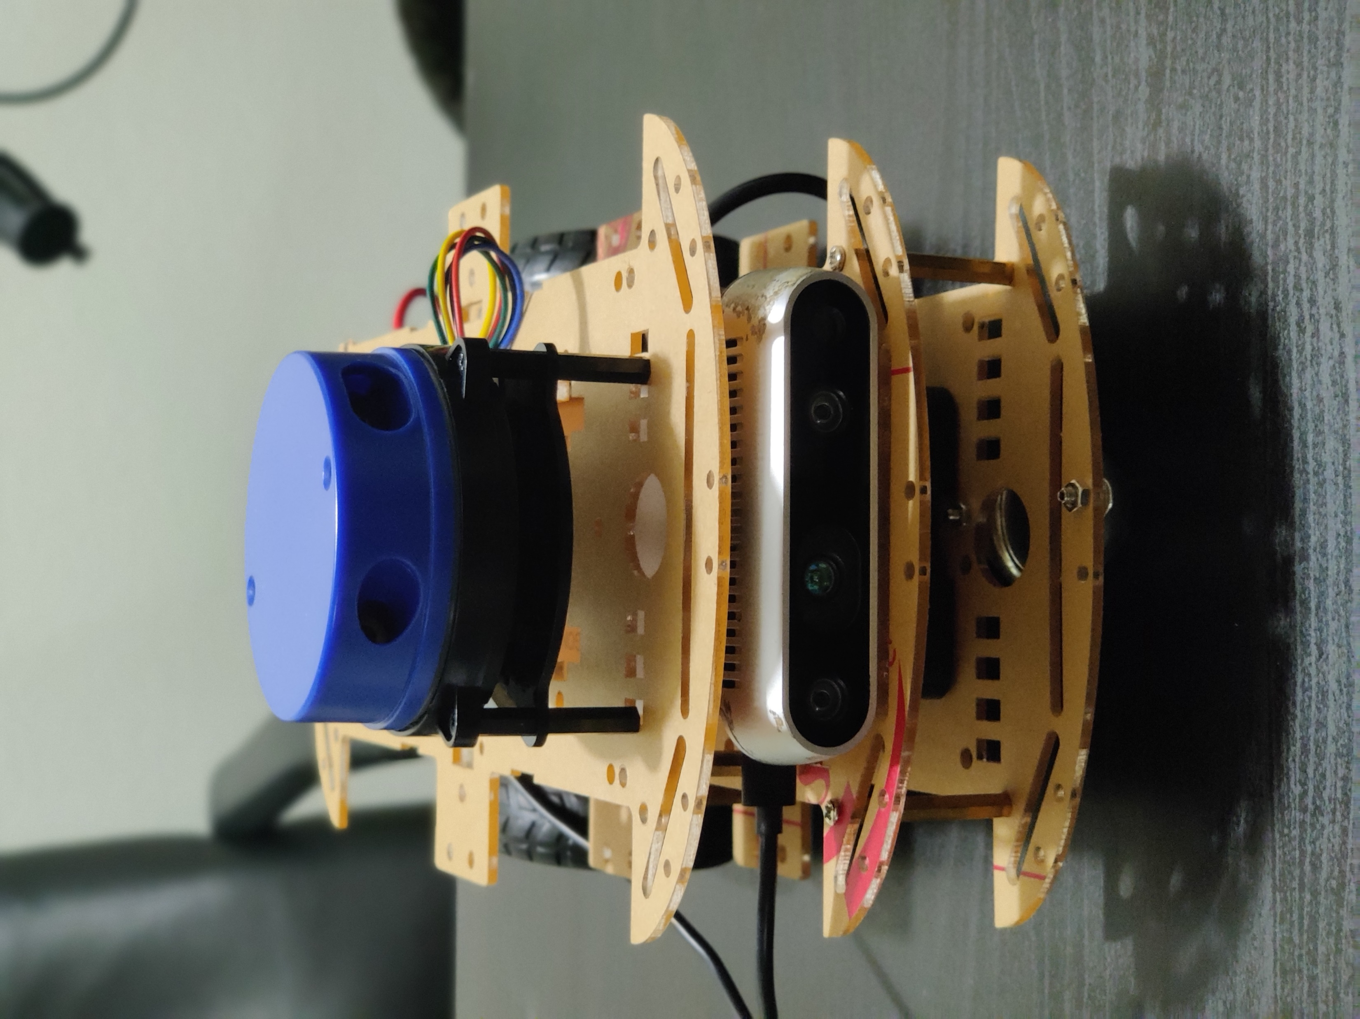
Controlled Using Twist Keyboard
For Autonomous Navigation

Slide 13
Result

Slide 14
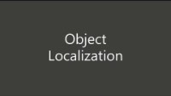

Slide 15
Learning
Robot Operating System (ROS)
SLAM
Robot Design.
Integrating ROS and Hardware.

Slide 16
Challenges
Using Pre-trained Model to Detect the Objects.
Detecting the Same objects multiple times while navigating.
Managing the Power Usage of Raspberry Pi.
Computation Power of Raspberry Pi

Slide 17
Questions ?

